Slide 1

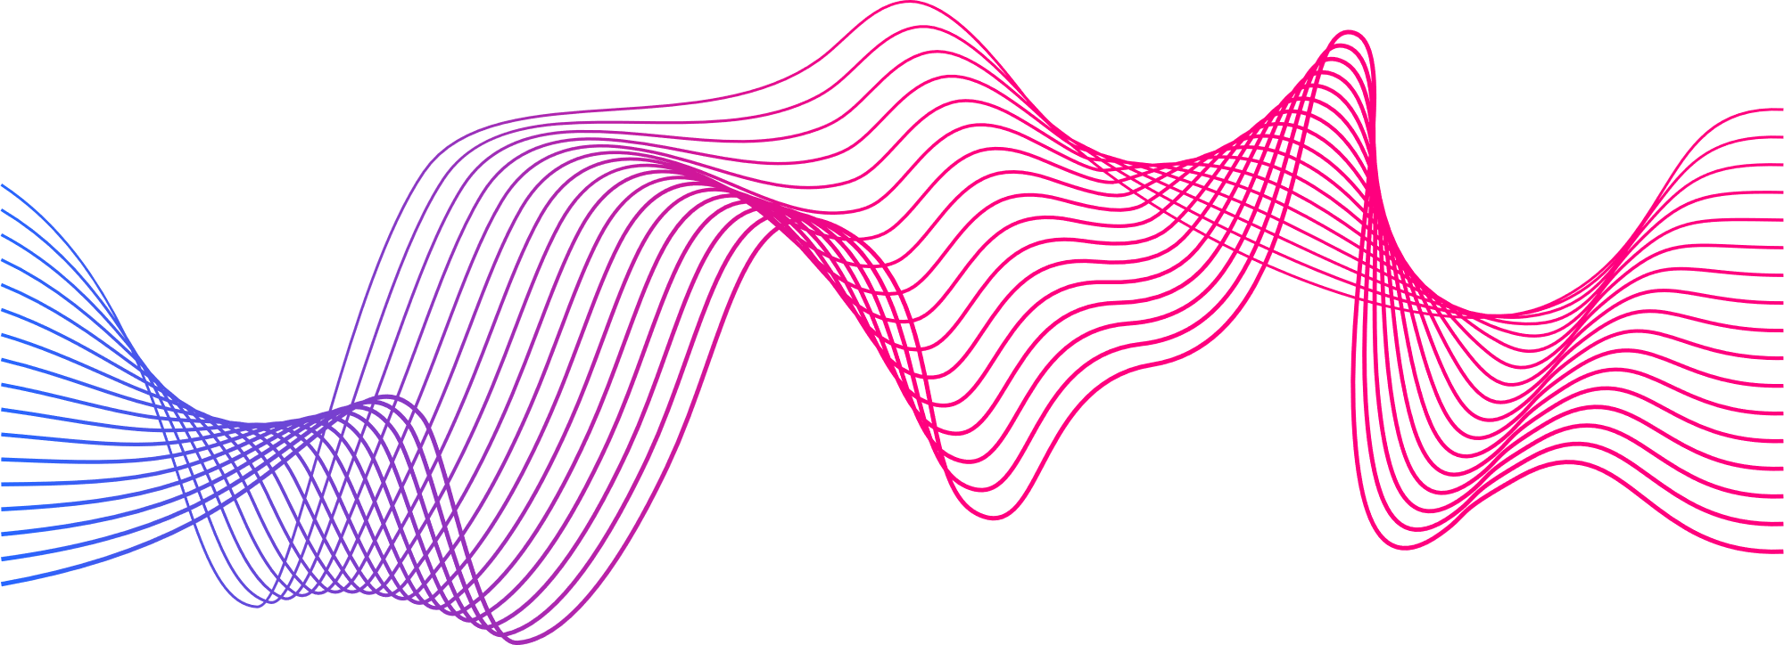
Sentiment Analysis in Code-Mixed Telugu-English Text with Unsupervised Data Normalization
G Vasudha 521134
AR Bhavana 521108

Slide 2


Problem Statement
In today's globalized world, multilingual communication has become increasingly prevalent. However, existing sentiment analysis models often struggle to accurately classify sentiment in code-mixed text due to the complexity introduced by language variations and structures. Therefore, the objective of this project is to develop a sentiment analysis model specifically tailored for code-mixed Telugu-English text. By incorporating unsupervised data normalization techniques, we aim to preprocess the text data effectively, without relying on labeled sentiment information.

Slide 3
Abstract
This study addresses sentiment analysis challenges in Code-Mixed Telugu-English Text (CMTET). The reason for choosing English as our secondary language for the Code-Mixed data is that we observed that most of the Telugu data available on social media is very often Code-Mixed with English. We introduced a new annotated data and Bi-LSTM set and applied a Recurrent Neural Network(RNN) model with a novel unsupervised data normalization technique, achieving 79.70% accuracy.

Slide 4
Pipe line for Proposed Model
RAW DATA
DATA PREPROCESSING
FEATURE VECTOR CONSTRUCTION
MODEL IMPLEMENTATION FOR SENTIMENT IDENTIFICATION
ANALYSIS AND EVALUATION OF MODEL

Slide 5
Libraries
1
Symspellpy
5
NLTK
2
Regular Expressions
6
Tensorflow
3
Numpy
7
Matplotlib
4
Pandas
8
Seaborn

Slide 6
Dataset
This dataset consists of data taken from the comments of social media platforms like Youtube and Twitter(formerly known as X).
This data is unstructured in nature and preprocessing has to be employed.

Slide 7
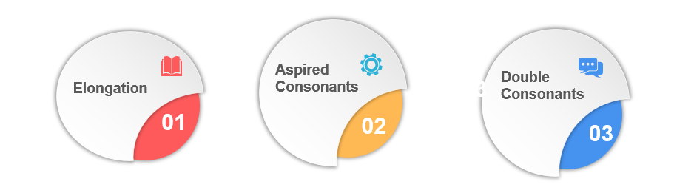
Challenges in CMTET
Examples:
”tinnnavaaa”,
”baguuundhiiii”,
”gooooood”, ”hellllllllo”
Examples:
Sariggga, tinnava
Examples:
“Dhara entha”

Slide 8
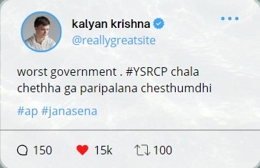
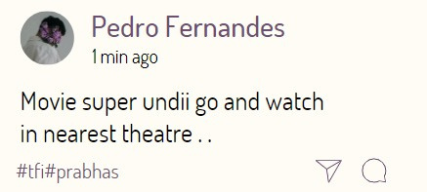
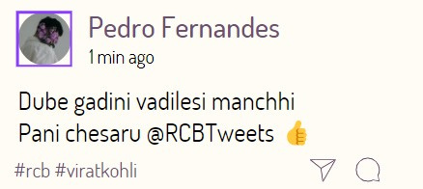

Slide 9
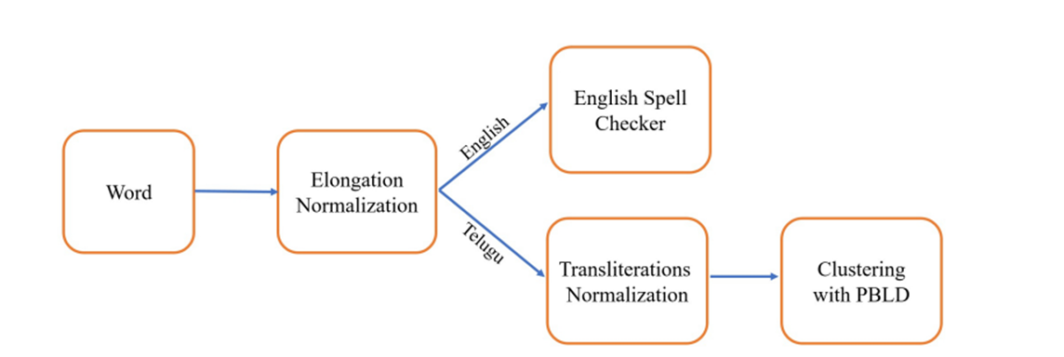
Data Normalization

Slide 10
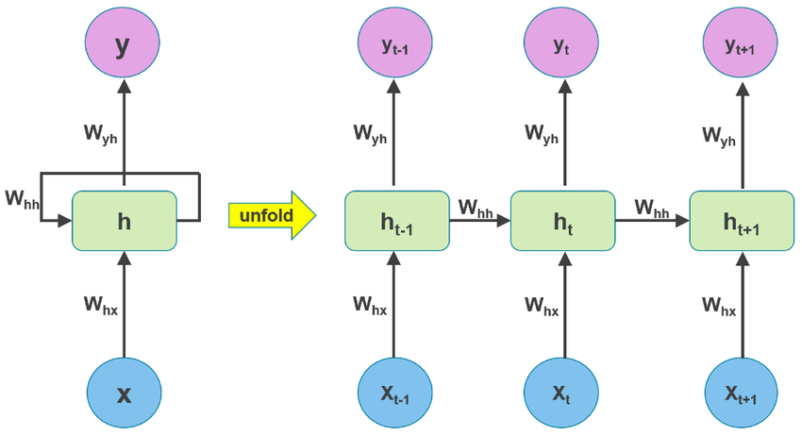
Recurrent Neural Network (RNN)
A Recurrent Neural Network (RNN) is a type of artificial neural network designed to efficiently process and analyze sequential data.
RNNs have loops within their architecture that allow them to persistently maintain and update internal state information.

Slide 11
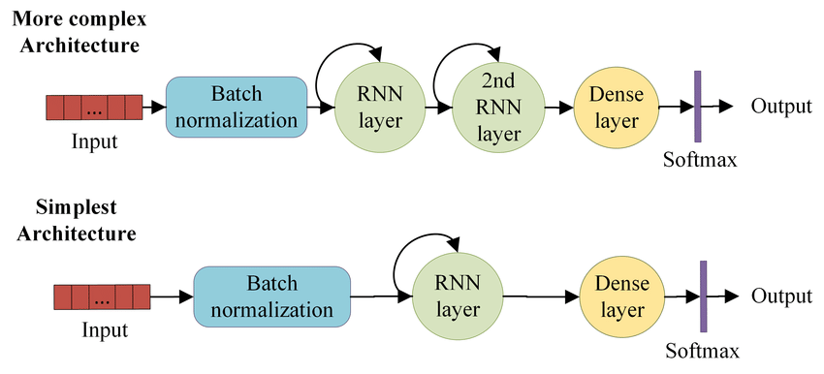
• The key feature of RNNs is their hidden state, which remembers information about the sequence. This hidden state allows RNNs to capture sequential dependencies by considering previous inputs during processing.

Slide 12
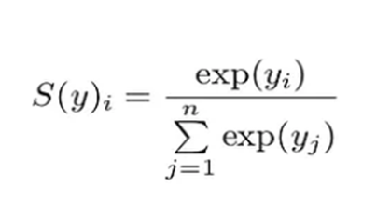
Activation Functions:
RELU
f(x)=max(0,x)
Widely used in hidden layers due to its simplicity and computational efficiency.
Tanh
f(x)=e^x+e^−x / e^x−e^−x​
tanh squashes input values to the range [-1, 1]. It is zero-centered, meaning it outputs values centered around zero.
Softmax
Softmax is an activation function commonly used in the output layer of a neural network for multi-class classification problems

Slide 13
Disadvantages of RNN
• Exploding Gradients: Exploding gradients occur when the algorithm gives the weights an absurdly high priority for no apparent reason. Fortunately, truncating or squashing the gradients is a simple solution to this problem.
• Vanishing Gradients: Vanishing gradients occur when the gradient values are too small, causing the model to stop learning or take far too long. Fortunately, LSTM concept solved the problem.

Slide 14
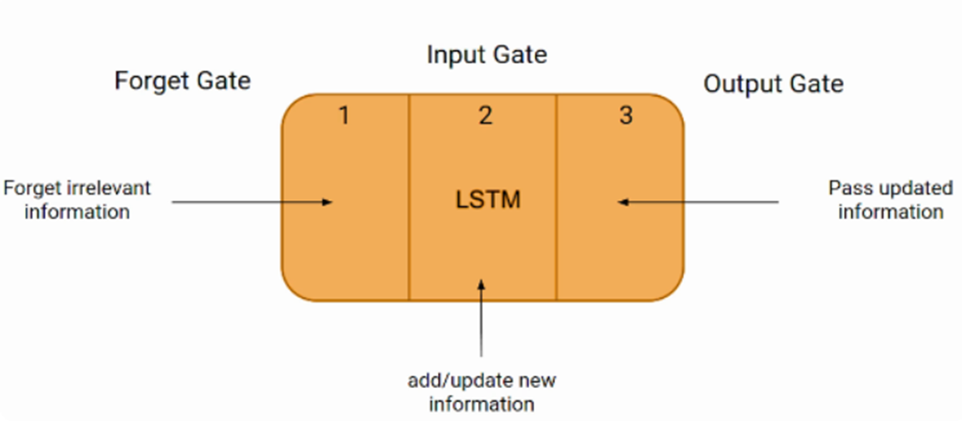
Long Short-Term Memory (LSTM)
LSTM (Long Short-Term Memory) is a recurrent neural network (RNN) architecture widely used in Deep Learning. It excels at capturing long-term dependencies, making it ideal for sequence prediction tasks.
?

Slide 15
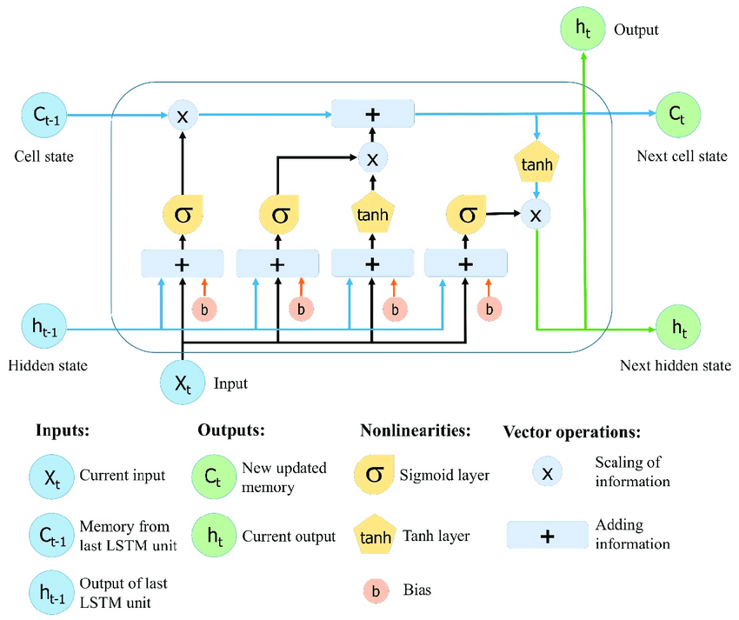

Slide 16
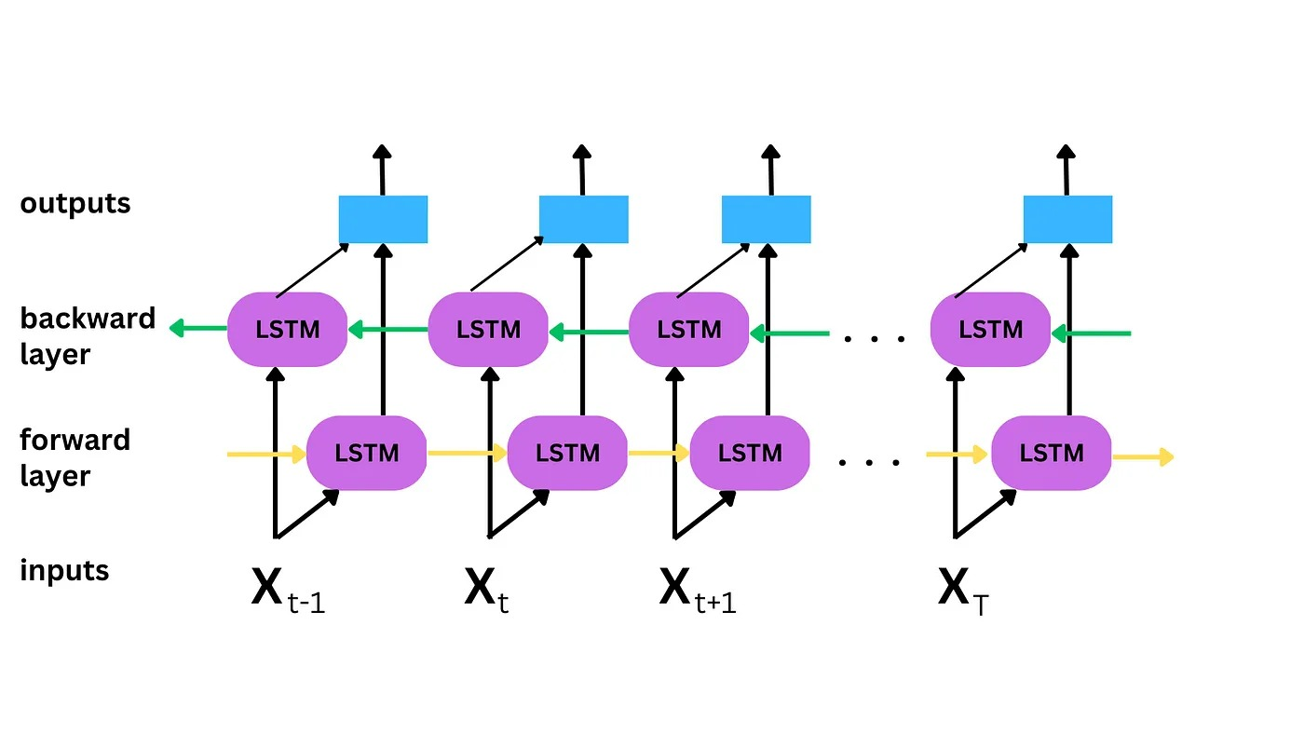
Bidirectional Long Short-Term Memory (BiLSTM)
Bi-directional LSTM has the ability to analyze inputs from both directions, namely, the past and the future timestamps. It is a much more powerful tool than the standard or unidirectional LSTM since it has the capability of utilizing information flowing from the past as well as future timestamps. the future timestamp essentially means the additional LSTM layer which works in the reversed direction. With respect to the past timestamp values, these reversed values which flow in the opposite direction are called future timestamp values.

Slide 17
Video link (as it is not uploading in youtube , we uploaded it in drive)
https://drive.google.com/file/d/1fALbTEyUBc4ZjYmCyRxmCx9eEWstqWgF/view?usp=drive_link

Slide 18
THANK YOU

